Slide 1
Development of Web Playground for Component and Connector Models
Master Thesis
by Ievgen Strepkov
2018 - October – 23rd
Prof. Dr. Bernhard Rumpe
Software Engineering
RWTH Aachen
http://www.se-rwth.de/
Notes:
Nicht löschen: Vorlage V35

Slide 2
Agenda
1.
Live Demonstration
2.
Related Work
3.
Requirements
4.
Toolchain

Slide 3
Live Demonstration
Live Demonstration

Slide 4
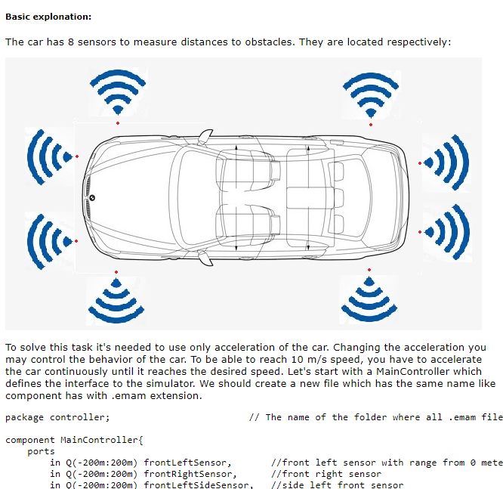
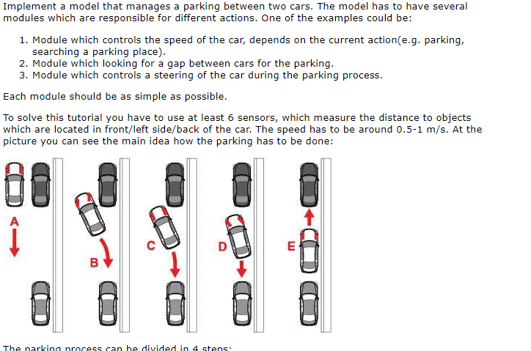
Tutorials
Eleven tutorials were created for demonstration purposes
Tutorials have increasing complexity
Detailed line solution explanation
Hints in task’s description

Slide 5
Agenda
1.
Live Demonstration
2.
Related Work
3.
Requirements
4.
Toolchain

Slide 6
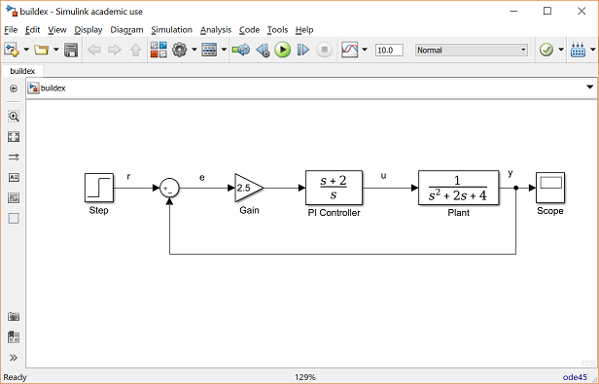
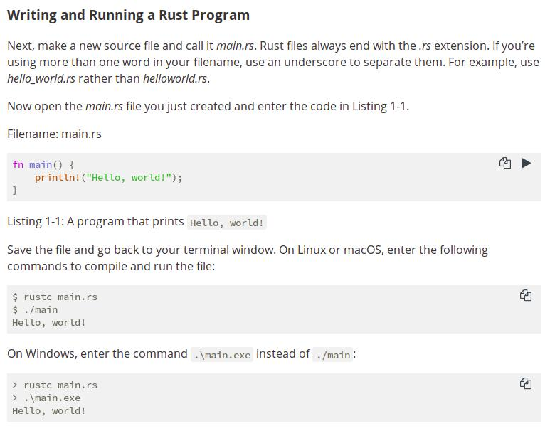
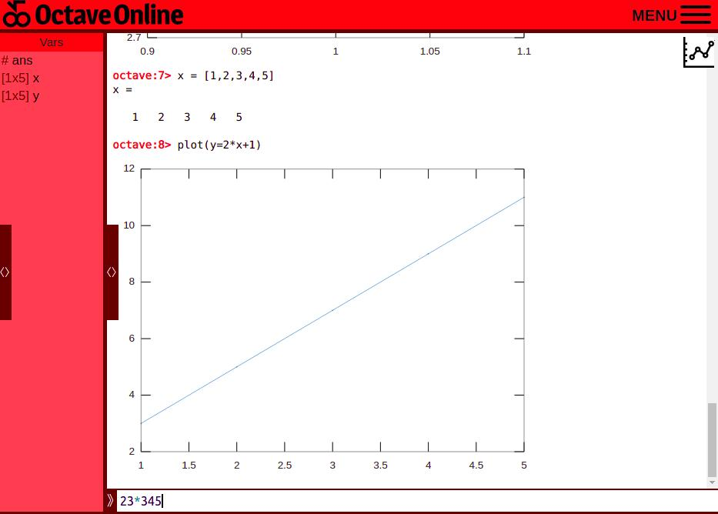
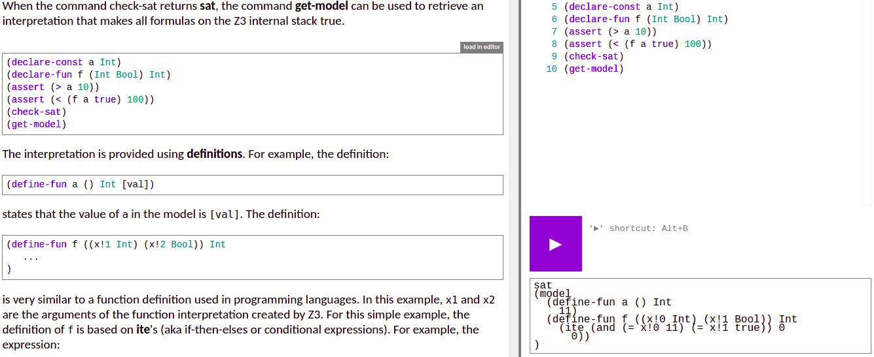
Related Work
Simulink
Rust
Octave Online
Microsoft Z3 Prover

Slide 7
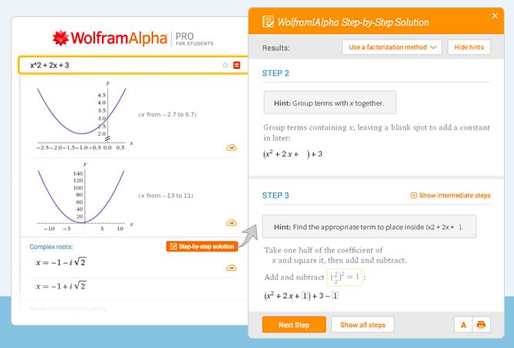
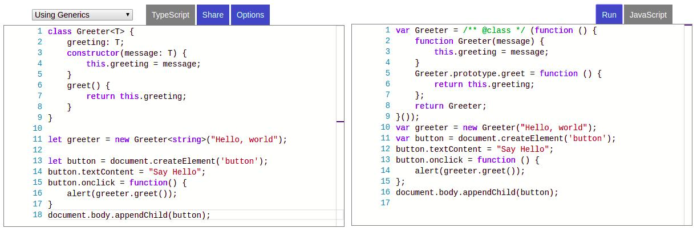
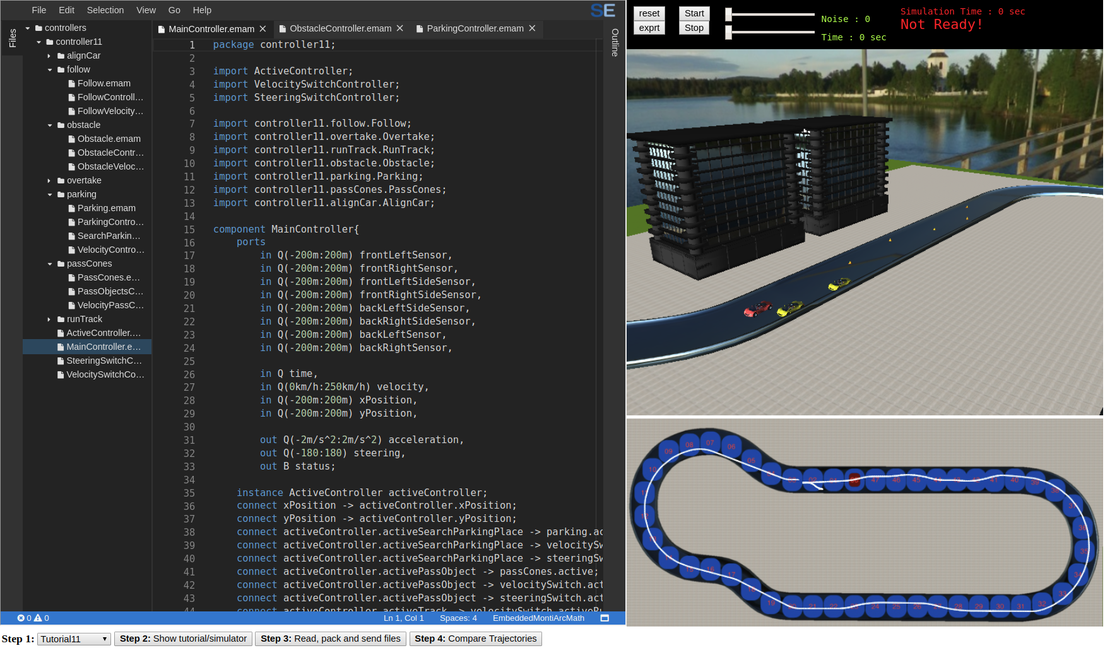
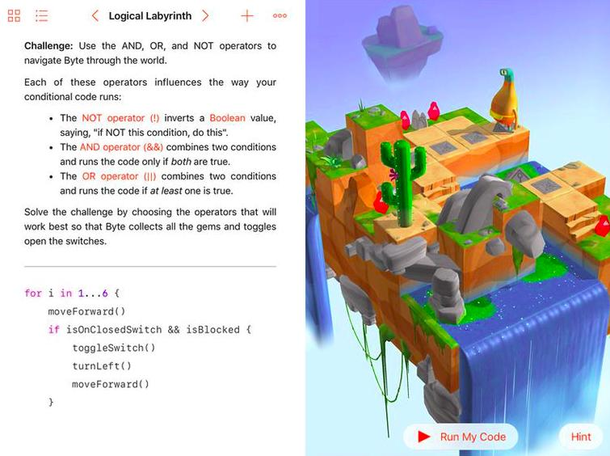
Related Work
TypeScript Playground
Wolfram Alpha
Swift Playground
EMA Tutorials

Slide 8
Agenda
1.
Live Demonstration
2.
Related Work
3.
Requirements
4.
Toolchain

Slide 9















Requirements
3D visualization
Simple, clean, and intuitive interface
Work on any operating system and without installation
Fast compilation
Import and reuse existing 3D models
Displaying object’s trajectory
Testing support
Veriﬁcation of results

Slide 10
Agenda
1.
Live Demonstration
2.
Related Work
3.
Requirements
4.
Toolchain

Slide 11
Toolchain – Architecture
Back-end
Front-end
Controller
WASM Gen.
3D visual.
Testing tool
Web Server
Online IDE
Simulator
Model
SVG Gen.
Trajectory
Traffic optimized exchange between front and back end
Stateless server

Slide 12
Toolchain – Typical Workflow
SD
:User
:Front-End
:Back-End
Select tutorial
Request data
Show tutorial
Return data
Compile
Send model
Ready state simulator
Return compiled model
Run simulation
Visualize simulation
Check result
Visual verification

Slide 13


Toolchain – Workflow
Compilation Step
Read files from IDE, pack and send to the server
Extract incoming files and process them
Pack compiled model and send it back
Extract the compiled model and initialize the simulator with compiled controller

Slide 14
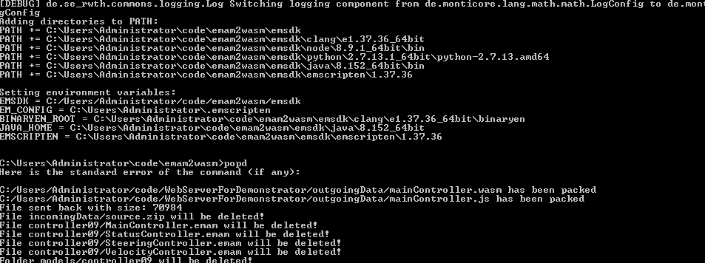
Toolchain – Server
Cross-platform java implementation
Based on the Jetty web server
Support pack/unpack of incoming/outgoing files
Easy to add new app to supply model’s files
Error handling support
Garbage collection

Slide 15
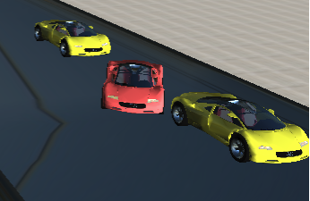
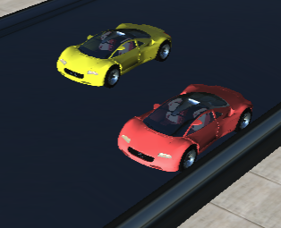
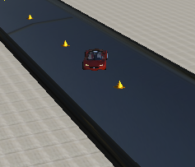
Toolchain – 3D Visualisation
Based on ThreeJS framework
Load different types of 3D models
Smooth execution using WebGL
Gamification

Slide 16
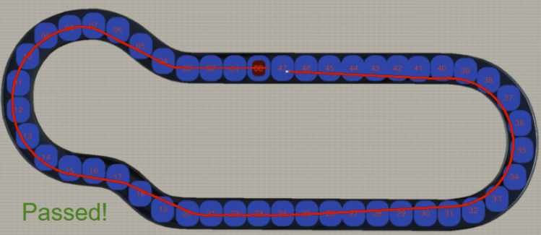
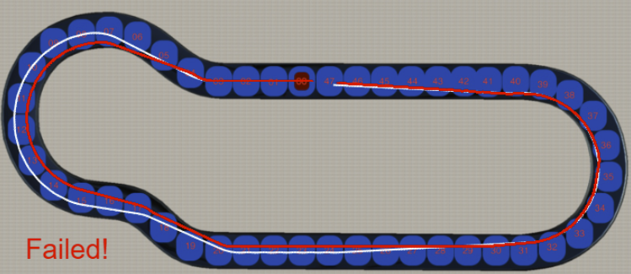
Toolchain – Trajectory builder
Build a trajectory using simulation log
Visual results comparison
Compare a trajectory deviation from sample

Slide 17
Thank You

Slide 18
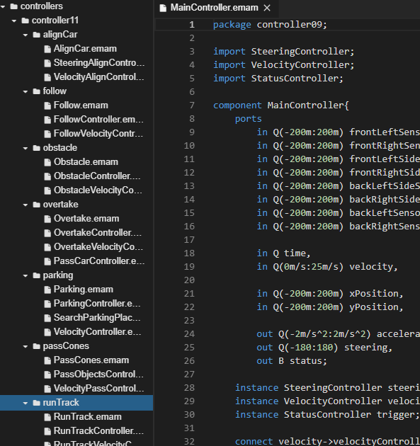
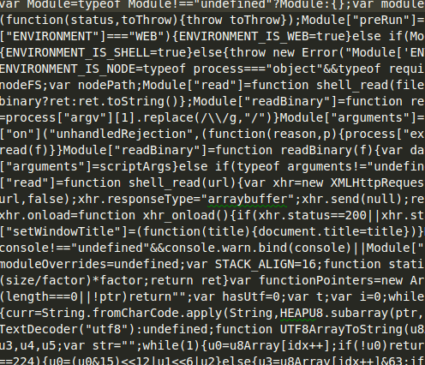
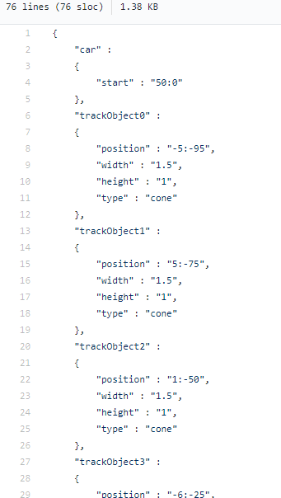
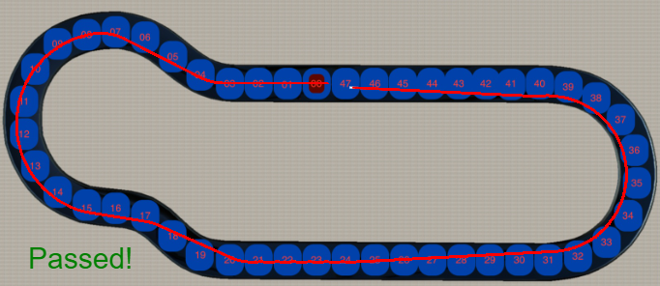
Tutorials
Each tutorial consist of six components:
Description
Solution’s description
Solution’s controller
Precompiled controller
Sample trajectory
Configuration

